Slide 1

AI-driven Prediction of Lung Cancer Risk Using Risk Factors and Symptoms
Jamil Hamad and Mariam El Dani

Slide 2
Outline
Introduction
Problem
Data Preparation
Exploratory Data Analysis
Model training and testing
Model Results and evaluation
Challenges
Next Step

Slide 3

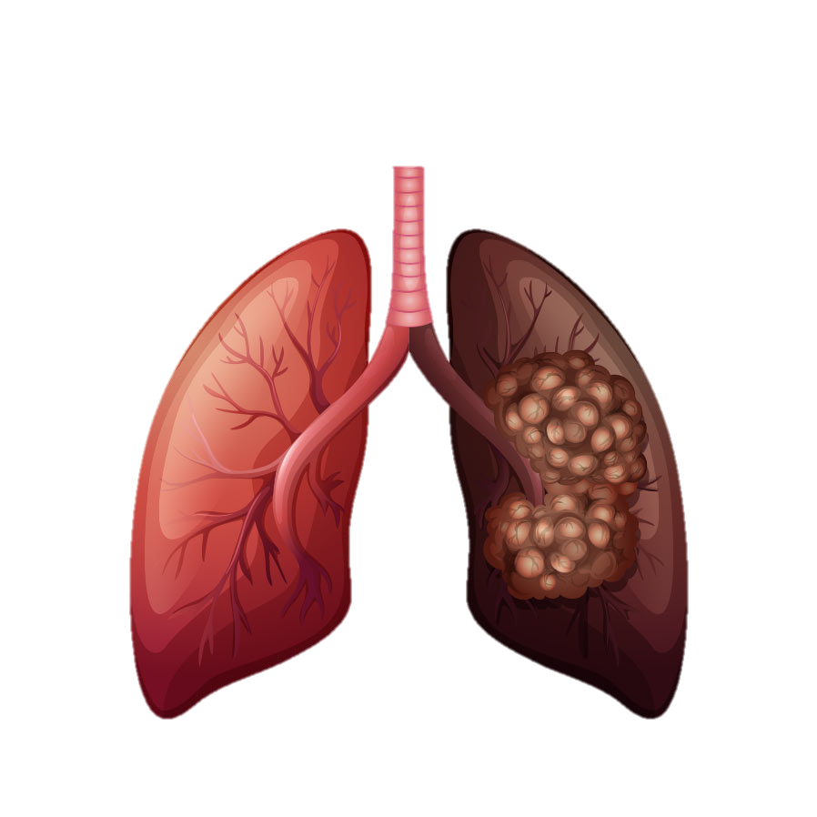

Introduction
According to WHO, Lung cancer is the leading cause of cancer-related deaths worldwide, accounting for the highest mortality rates among both men and women
Lung cancer is often diagnosed at advanced stages when treatment options are limited
The 5-year survival rate for lung cancer is only 18%

Slide 4

Problem
Physical examinations and medical imaging (X-Rays, MRIs, CT scans) can be time-consuming and expensive
-> Machine-learning algorithms might be beneficial in forecasting the risk of lung cancer at low cost
-> Early diagnosis, better prognosis

Slide 5
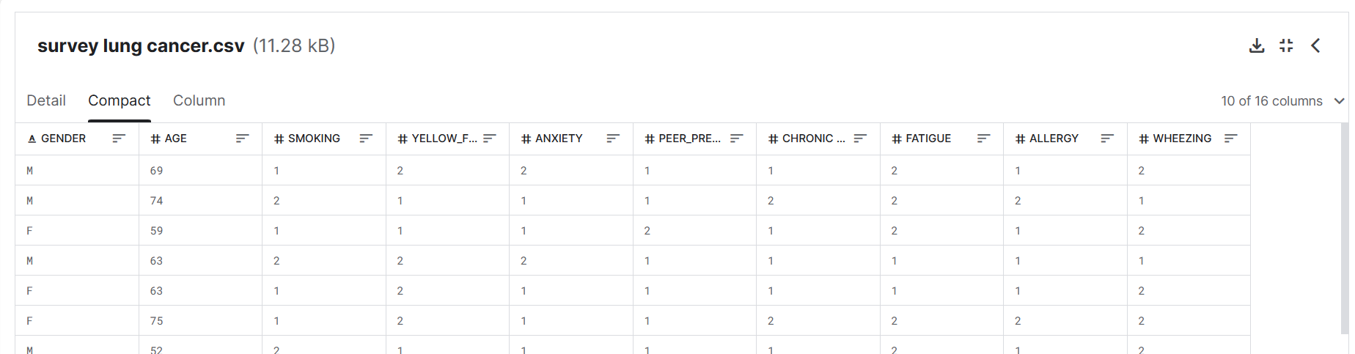
Data Preparation
Data was downloaded from Kaggle.com
It included 309 participants and 16 variables (risk factors/symptoms and lung cancer status):
Age, Gender, Smoking, Yellow fingers, Anxiety, Peer pressure, Chronic disease, Fatigue, Allergy, Wheezing, Alcohol consumption, Shortness of breath, Swallowing difficulty, Chest pain, Lung cancer

Slide 6
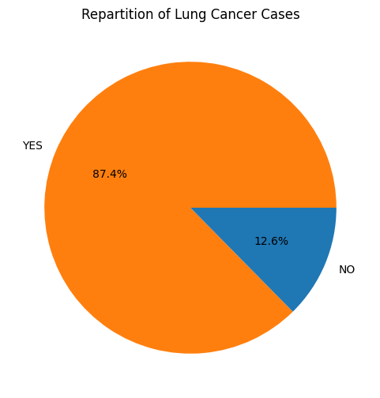
Exploratory Data Analysis
309 participants:
270 (87.4%) lung cancer positive
39 (12.6%) lung cancer negative

Slide 7
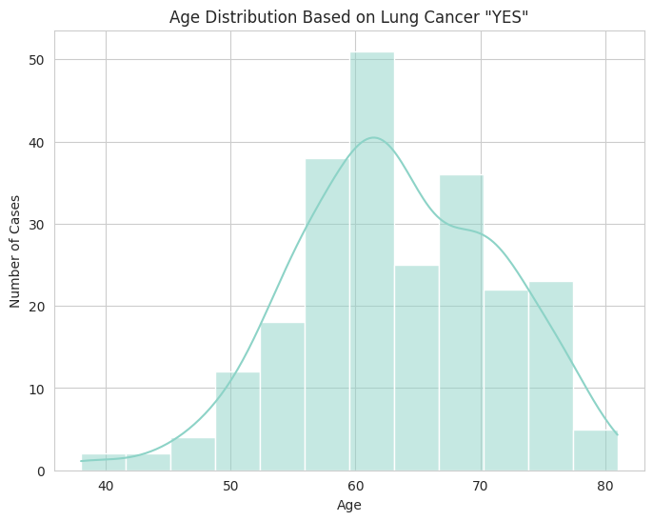
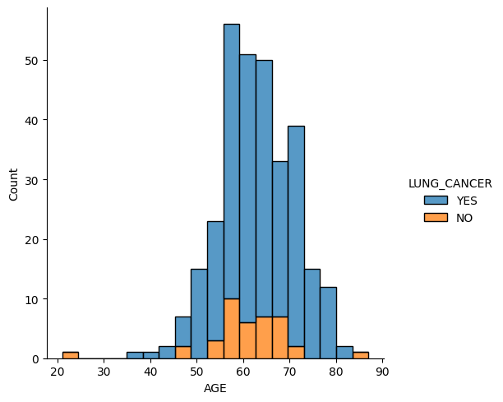
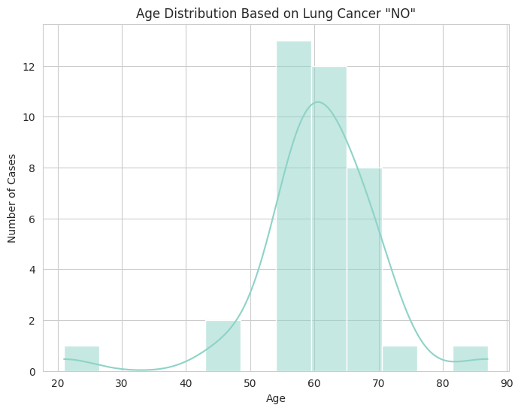
Correlation between Age and Lung cancer
t-test
p value=0.12

Slide 8
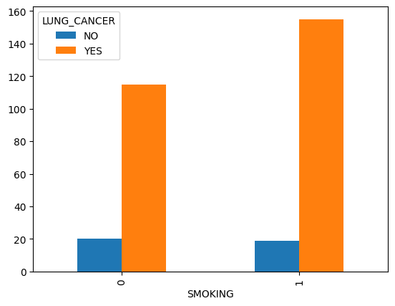
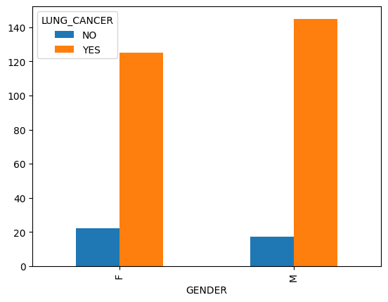
Correlation between Smoking/Gender and Lung cancer
chi square test
p value=0.69
chi square test
p value=0.47

Slide 9
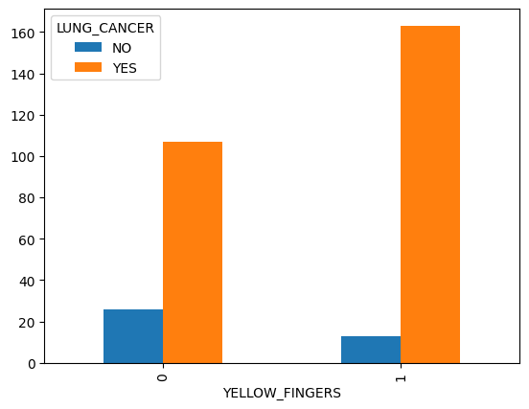
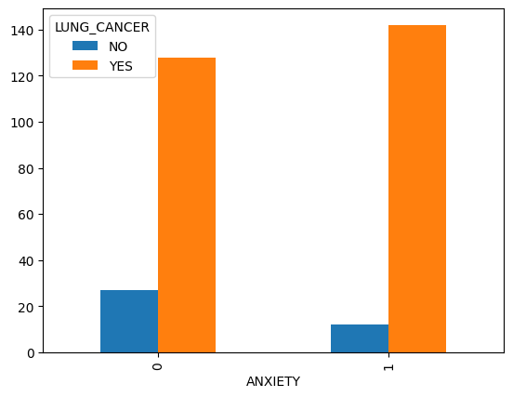
Correlation between Yellow Fingers/Anxiety and Lung cancer
chi square test
p value=0.003
chi square test
p value=0.26

Slide 10
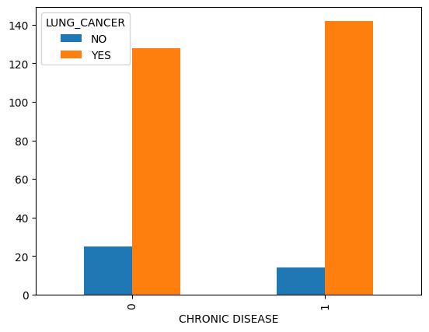
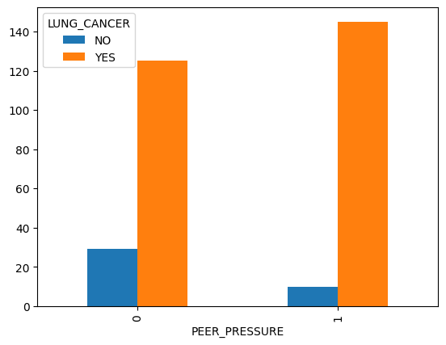
Correlation between Peer pressure/ Chronic disease and Lung cancer
chi square test
p value=0.027
chi square test
p value=0.002

Slide 11
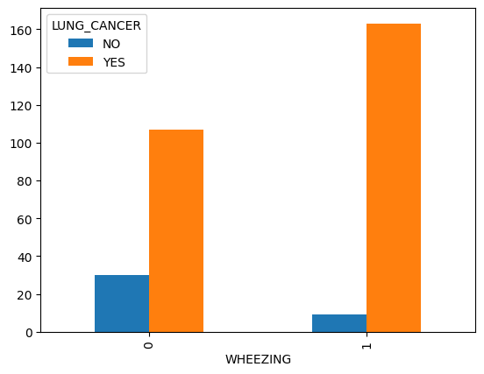
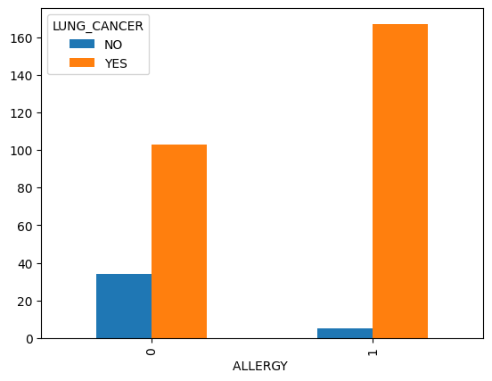
Correlation between Allergy/ Wheezing and Lung cancer
chi square test
p value<0.001
chi square test
p value<0.001

Slide 12
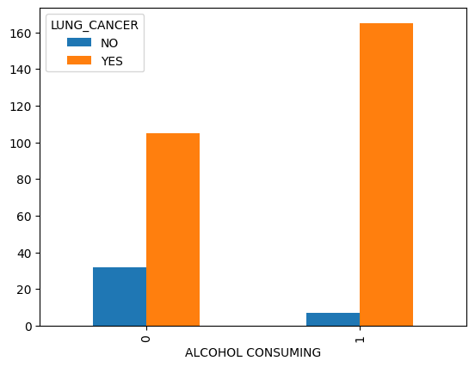
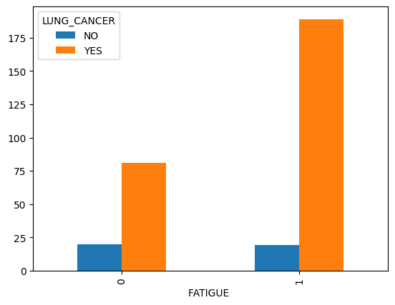
Correlation between Fatigue/Alcohol consumption and Lung cancer
chi square test
p value<0.013
chi square test
p value<0.001

Slide 13
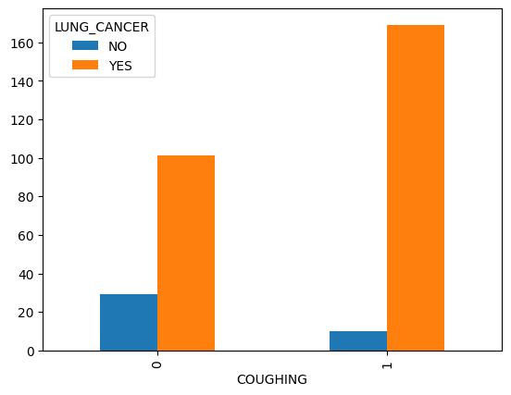
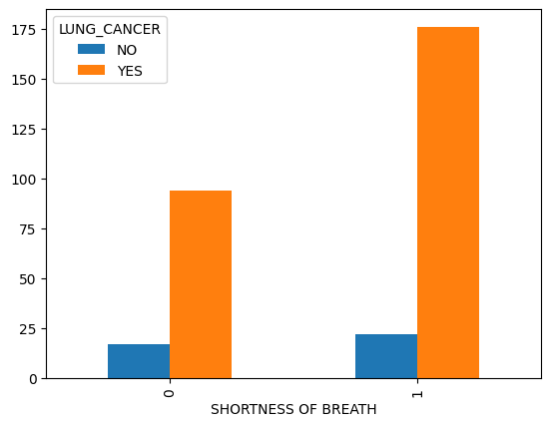
Correlation between Coughing/ Shortness of breath and Lung cancer
chi square test
p value<0.001
chi square test
p value=0.37

Slide 14
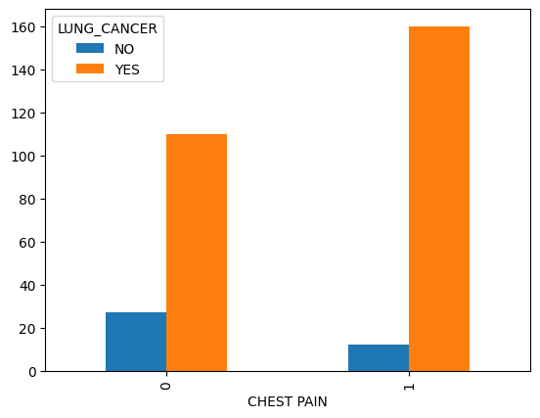
Correlation between Chest Pain and Lung cancer
chi square test
p value=0.002

Slide 15
Data pre-processing
No missing data
33 duplicates were removed
-> resulting in a total of
238 lung cancer positive participants and 38 lung cancer negative participants
Data encoding:
Lung cancer (YES/NO) and Gender (M/F) -> converted to numerical ones (1/0)
Normalization:
Dividing all the columns by the maximum of each column -> normalized to (1/0)

Slide 16
Model training and testing
The dataset was split into an 80/20 training/testing sets
220 Training data points
56 Testing data points

Slide 17
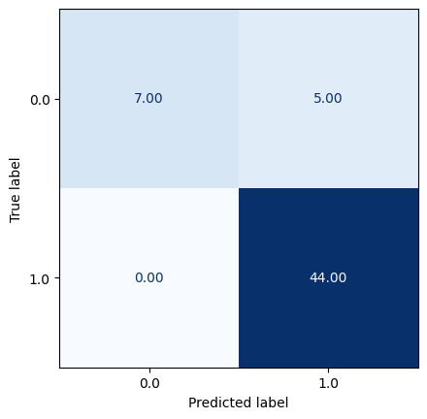
Model results and evaluation
Logistic regression model
Train accuracy score: 0.92
Test accuracy score: 0.91
Precision: 0.9
Recall: 1
Confusion matrix:
Zero false negatives
Five false positives
Notes:
Precision, or specificity, tells us the ability of the model to correctly identify people without the disease. Recall, or sensitivity, tells us how well the model identifies people with the disease.

Slide 18
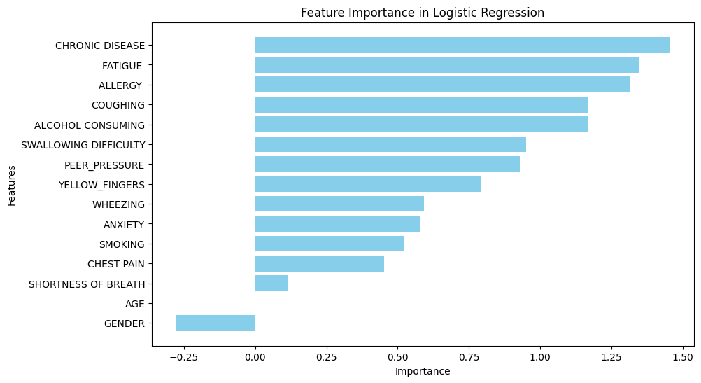
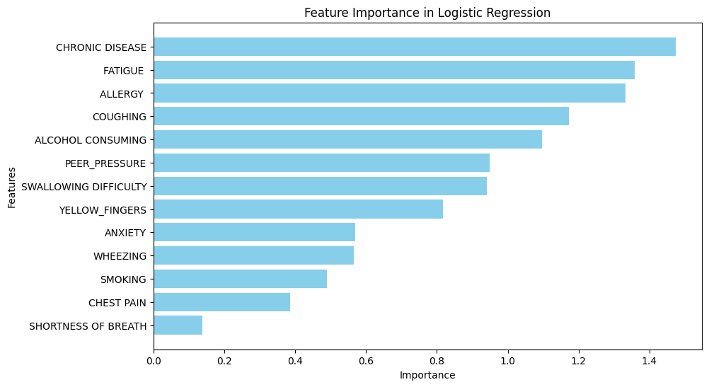
Feature Importance in Logistic Regression

Slide 19
Challenges
Relatively small sample size
Lack of data on:
Whether lung cancer positive participants are in early or advanced stages
Family history of cancer
Exposure to second-hand smoking
Occupational exposures (i.e; asbestos)

Slide 20
Next step
Random Forest Classification
Naive Bayes
Gradient Boosting Classifier
Testing and comparing the logistic regression model with other models

Slide 21
Thank you
Any questions ?

